Slide 1


KYAMBOGO UNIVERSITY
Final Year Project:
Department of Electrical and Electronics Engineering
GSM Signal Denoising and Modulation Classification for Rural Uganda
Improving Connectivity in Underserved Areas Using Machine Learning
Ssemujju Sharif Abdukarim
18/U/ETD/181/GV
Kisige Tom Derrick
22/U/ETD/0953/GV
Supervisor: Dr. Dickson Mugerwa

Slide 2
Proposal Outline
1
Background
7
Methodology
2
Problem Statement
8
Tools and Equipment
3
Objectives
9
Project Timeline
4
Justification
10
Significance
5
Scope of the Project
11
Conclusion
6
Literature Review
12
References

Slide 3
Background
33.2 million Ugandans
exchanged
421.5 million GBs
in 2022
31% of Ugandans
have 4G
62% of Ugandans
Lack mobile internet access
Most Ugandans still use basic phones
UCC reports that network subscriptions reached 33.2 million by the end of 2022, and mobile data traffic doubled from 217 million GB in 2020 to 421.5 million GB in 2022 showing an exponential growth in network service demand. [1]
Unfortunately, network expansion is failing to keep pace with this demand; only 31% of the population and 24% of the landmass have 4G coverage and 62% of the population (30 million people) still lacks mobile internet access, and live in low SNR, high-interference environments where the signal is weak (below -90 dBm), the noise becomes louder than the message, making it impossible for standard tools to understand what is being sent[3][4][5][6]
Many people in rural Uganda still use basic phones for calls and Mobile Money, but the signal is often very weak and are being blocked or "noised up" by illegal boosters, unlicensed community radios (Bizindaalo), and heavy tropical rain. [7][23][24][25]

Slide 4

Background continuation
Automatic Modulation Classification (AMC) is crucial for regulators to monitor the spectrum, manage interference, and identify illegal broadcasters that threaten critical services like aviation. [7]
The project proposes using a Denoising Autoencoder (DAE) combined with an Automatic Modulation Classifier (AMC) system that takes a noisy signal (e.g., at -90 dBm or even lower) and actively cleans it up removing noise before trying to classify or demodulate it. [5][8][15][26]
Instead of just trying to read a noisy signal, the proposed system first cleans the signal to make it clear again making sure that even in the most remote sub-counties, the network can still identify and process signals correctly. [8][15][26]

Slide 5
Problem Statement
UCC's 2024 coverage framework defines 2G/GSM service using a minimum outdoor signal threshold of -90 dBm (RxLEV). However, some rural locations do not consistently meet this threshold. In such weak-signal conditions, current monitoring approaches such as field measurements, drive tests, walk tests, and coverage simulations can confirm weak coverage but can't reliably identify and classify signals because transmissions are buried in interference and noise. [5][27]
Signal quality is further degraded by illegal boosters, unlicensed community radios (Bizindaalo), and heavy tropical rain. Illegal boosters raise interference, unlicensed transmitters can inject harmful harmonics, and rain fade attenuates the radio path and microwave backhaul. [7][23][24][25]
UCC therefore finds it difficult to detect illegal broadcasters and diagnose interference when both legitimate and harmful signals are buried in low-SNR, interference-heavy conditions. [7][23][27]
This leads to dropped calls, failed Mobile Money transactions, and poor service in areas where reliable connectivity is most needed. [3][6][27]
We therefore lack a robust preprocessing mechanism that can clean weak GSM-family signals before modulation classification and further signal analysis. [8][15][26]

Slide 6
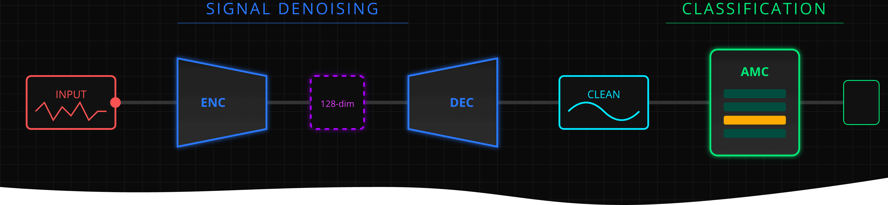
Main Objective
Design a Hybrid DAE–AMC Pipeline
To design, implement, and empirically evaluate a hybrid Denoising Autoencoder–Automatic Modulation Classification (DAE–AMC) system that suppresses interference in noisy I/Q streams and maintains accurate modulation decisions across low SNR channel conditions observed in Ugandan networks.

Slide 7
Specific Objectives
01 Design
Define the hybrid DAE-AMC architecture, select the working datasets, and model Uganda-specific low-Signal to Noise Ratio (SNR) interference conditions such as booster oscillation, Bizindaalo harmonics, and rain fade
02 Implementation
Develop and train a one-dimensional convolutional denoising autoencoder, implement the AMC classifier for GSM-family modulations, and integrate both blocks into a single signal-processing pipeline.
03 Analysis
Evaluate the hybrid DAE-AMC pipeline against a standalone AMC baseline using accuracy, F1-score, confusion matrices, and SNR-wise performance trends.

Slide 8
Justification and Significance
Meeting UCC Mandates:
It Aligns with National Policy:
UCC's 2024 coverage framework defines 2G/GSM service using a minimum outdoor signal threshold of -90 dBm (RxLEV), while UCC QoS reporting tracks service thresholds such as blocked and dropped call performance. By targeting weak-signal and interference-heavy conditions around this coverage floor, the proposed DAE-AMC pipeline is aligned with the regulator's need for more reliable monitoring and diagnosis in underserved areas. [5][27]
The proposed ML system supports Uganda's connectivity-expansion agenda by complementing conventional feature-engineered signal analysis with a learnable denoising-and-classification system that is better suited to weak-signal, interference-heavy conditions. [4][15][26]
Spectrum Surveillance
UCC already uses monitoring, measurement, and complaint-handling mechanisms for spectrum oversight. The added value of the proposed system is not basic automation, but low-SNR signal recovery and modulation classification when transmissions are buried in interference and noise. This can strengthen interpretation of weak illegal or harmful transmissions during monitoring and subsequent enforcement analysis, especially for protected services such as aviation and public safety. [7][23][31][32]

Slide 9
Justification and Significance
Critical Services
More reliable weak-signal interpretation can support voice communication, Mobile Money, and other essential services that depend on stable rural mobile links. [5][6]
Rural Mobile Connectivity
The direct focus of this project is reliable rural mobile connectivity rather than broadband throughput alone. By improving signal interpretation near the coverage floor, the proposed system supports more stable GSM/2G service conditions in underserved areas where weak coverage and interference coexist. [3][5][6][27]

Slide 10
Scope
1. Offline Experimentation
Project conducted entirely on a computer using pre-existing data, ensuring a controlled environment.
2. Datasets
DeepSig RadioML 2018.01A benchmark data provides synthetic, well-characterized SNR labels, while the RF Signal Data collection on Kaggle provides real SDR captures that introduce hardware impairment realism. [11][12]
3. Noise Modelling
We inject Uganda-specific noise profiles such as Booster oscillation noise as High-power wideband impulses simulating illegal repeater feedback, Bizindaalo harmonics as Narrowband tones at 2nd/3rd harmonics of FM frequencies (200 MHz, 300 MHz sidebands leaking into 900 MHz), Rain fade attenuation as Time-varying SNR reduction modeling tropical storm conditions (100+ mm/h rainfall rates)
4. Model Development
Focus on a One Dimensional Convolutional Denoising Autoencoder (DAE) and a supervised AMC classifier.
Specific Modulations
Training models to recognize GSM-family modulations like GMSK, GFSK, and QPSK
Platform & Tools
Python, PyTorch, Jupyter Notebook, and supporting visualization or cloud tools where needed.
Timeline
A 6-month dedicated period for research, model development, and comprehensive testing.

Slide 11

Literature Review
Chapter Two

Slide 12
Classical Methods
Early Automatic Modulation Classification (AMC) relied mainly on statistical analysis, likelihood-based decision rules, and manually engineered signal descriptors such as higher-order moments and cyclostationary properties. These approaches are analytically elegant and can perform well in controlled settings, but their performance degrades sharply when channel conditions are unknown or when the received signal is weak and interference-heavy
.
Key Limitation:
Classical AMC methods depend on stable channel assumptions and carefully engineered signal descriptors.
In congested and interference-affected deployments such as those documented by UCC, weak-signal and noise-heavy conditions make those descriptors less reliable, motivating the transition toward data-driven learning approaches. [7][23][27]
Machine learning as the new standard
Modern research has shifted to deep learning models such as CNNs, Transformers, and Mixture-of-Experts frameworks. These models can learn signal characteristics directly from raw signal data and have shown significant accuracy improvements, especially in low-SNR conditions down to 0 dB. [15][16][26]

Slide 13
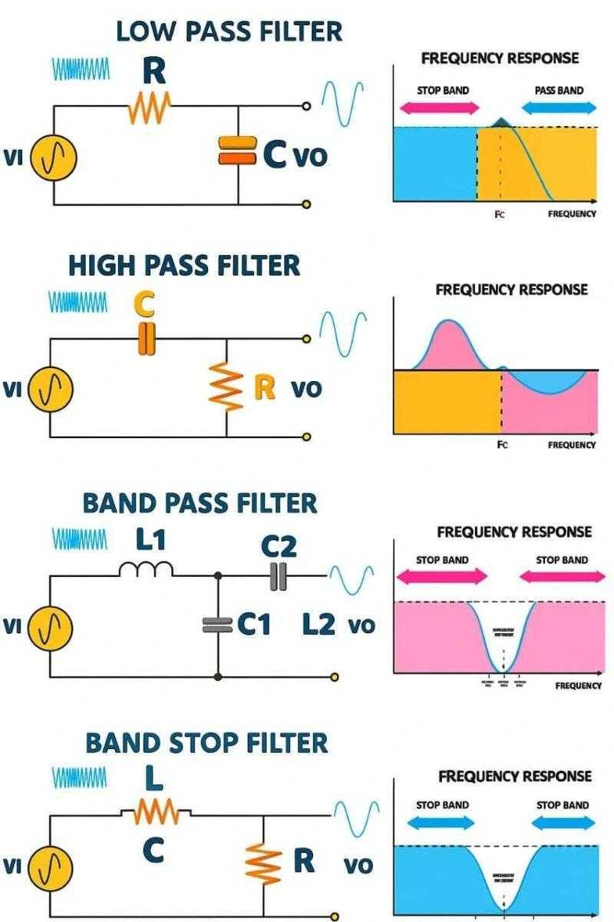
GSM Noise Mitigation in African Networks
Current Technical Practice
In classical communication receivers, noise mitigation is usually performed before classification through predefined digital signal processing filters. Band-pass and low-pass filters are used to retain the frequency region of interest while suppressing out-of-band noise, matched filters are used to maximize the signal-to-noise ratio when the expected pulse shape is known, and notch or adaptive filters may be applied to suppress narrowband interferers. These approaches are effective when the channel characteristics, signal bandwidth, and interference structure are reasonably known in advance. However, their performance degrades when the interference is non-stationary, broadband, nonlinear, or only partially known, because the filter parameters are fixed or depend on assumptions that may not hold in real deployments. As a result, classical filter-based denoising can improve signal quality, but it often struggles to recover weak signals reliably in low-SNR, interference-heavy environments.
We address that gap by training a DAE on synthetic noise profiles matching documented interference vectors, enabling GMSK classification at SNR levels where conventional approaches fail. [8][15][26]

Slide 14
Machine Learning in AMC
Deep learning has reshaped AMC by learning discriminative signal characteristics directly from raw I/Q samples. Recent contributions demonstrate tangible low-SNR gains:
AbdElaziz et al. (2023)
1
CNN with parallel asymmetric kernels achieved 96.5% accuracy at 0 dB and 86.1% at −2 dB across nine modulations. [15]
2
Zhang et al. (2023)
MoE-AMC mixture-of-experts framework yielded ~71.8% averaged accuracy across −20…18 dB. [16]
Meta-Transformer (2024)
3
Leverages transformer encoders and few-shot learning to adapt rapidly to unseen modulations while maintaining superior accuracy. [30]
4
Rehman et al. (2025)
DL AMC converts I/Q streams into eye diagrams, overcoming the 10–48% accuracy ceiling near −10 dB SNR.

Slide 15
Denoising Autoencoders for Signal Enhancement
Denoising frontends have emerged as an effective countermeasure when raw I/Q features are overwhelmed by interference.
75%
77.5%
70%
Classification accuracy across −12…8 dB .
accuracy at −10 dB
relative accuracy gains on low-SNR samples.
Dual residual DAE with channel attention improved AMC accuracy by up to 75% across −12…8 dB SNR. [8]
Faysal et al.'s multimodal denoising masked autoencoder sustained 77.5% accuracy at -10 dB, roughly 22% higher than the non-denoised case. [28]
An and Lee's thresholded autoencoder with an SNR predictor delivered about 70% relative accuracy gains on low-SNR samples. [29]
These findings justify the DAE-AMC architecture explored in this project and provide design cues for gating strategies that conserve energy on SDR deployments. [8][26][28][29]

Slide 16
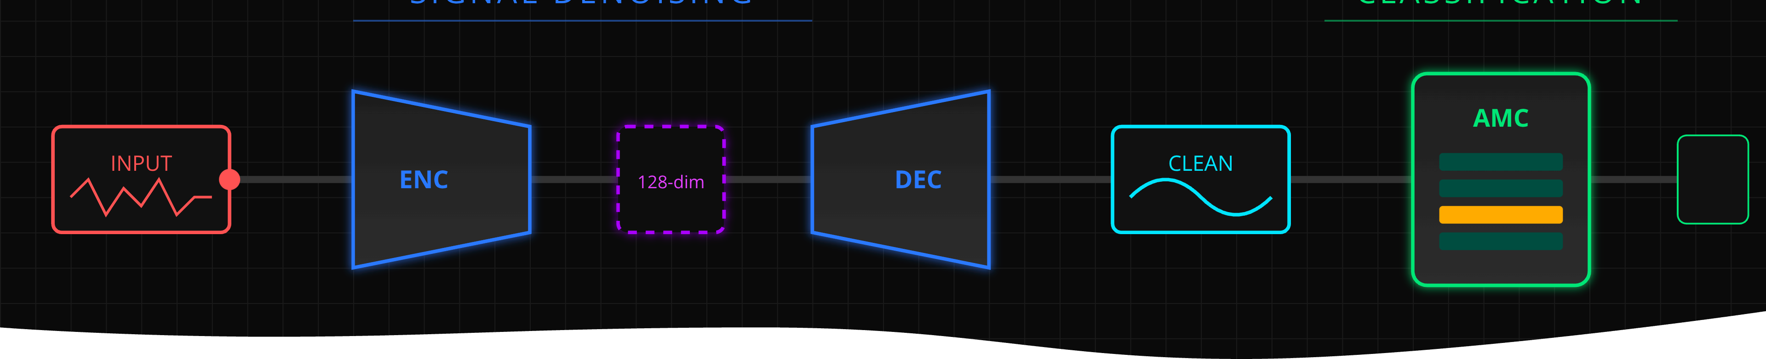
CHAPTER THREE – METHODOLOGY
A comprehensive framework for developing robust Automatic Modulation Classification systems tailored to challenging RF environments through deep learning and denoising techniques.

Slide 17



01
DESIGN
This stage defines the full architecture and experiment setup before training begins.
- Select the datasets to be used, primarily RF Signal Data and RadioML 2018.01A. [11][12]
- Harmonize all signals into a unified tensor format with 1024-sample windows and normalized amplitude.
- Perform exploratory data analysis (EDA) to inspect class balance, SNR coverage, waveform quality, and impairment patterns before training. [11][12]
- Define the GSM-focused modulation classes: GMSK, GFSK, and QPSK.
- Model Uganda-specific interference using booster oscillation, Bizindaalo harmonics, and rain-fade attenuation. [7][23][24][25]
- Specify the system architecture showing how the denoising block feeds the modulation classifier.

Slide 18
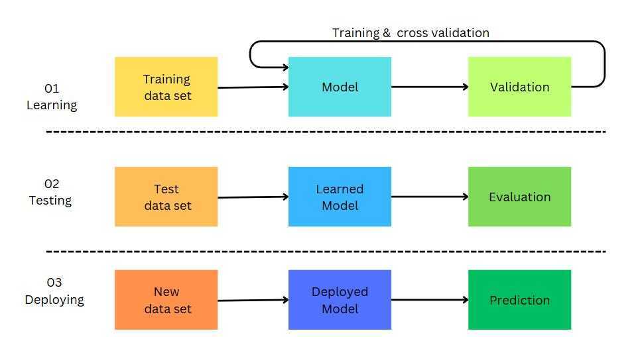
Methodology
02
IMPLEMENTATION
- Train a Conv1D encoder-decoder DAE on noisy and clean I/Q pairs using MSE-based reconstruction loss. [8][26][28]
- Train a supervised AMC classifier on GSM-family modulations using both raw and denoised inputs. [15][16]
- Integrate the DAE and AMC blocks into a hybrid pipeline and compare frozen and fine-tuned configurations. [8][26][28][29]
- Build a lightweight prototype interface for visualizing noisy signals, denoised outputs, and classification predictions.

Slide 19
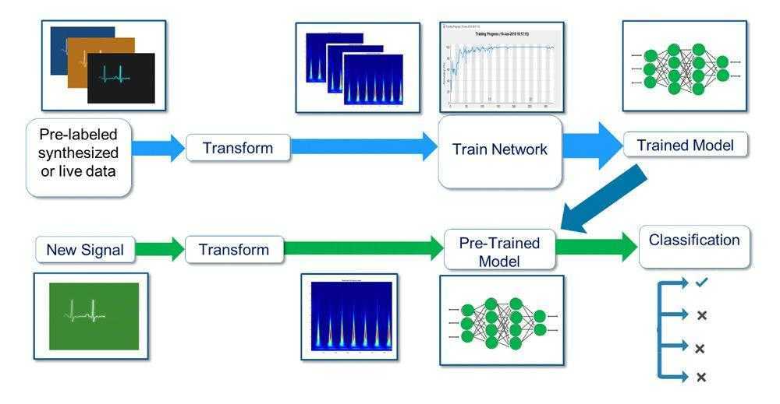
Methodology
03
ANALYSIS AND EVALUATION
- Benchmark the hybrid DAE-AMC system against a standalone AMC baseline. [15][16]
- Evaluate denoising quality and classification quality across held-out SNR ranges. [8][26][28][29]
- Use accuracy curves, macro F1-score, confusion matrices, and SNR-wise comparisons to quantify improvement. [15][16][26]
- Interpret the results in terms of rural Uganda use cases such as weak-signal monitoring, interference diagnosis, and regulator demonstrations.
Expected outcome: A clear evidence set showing where the hybrid pipeline improves over baseline AMC, including result plots, comparative metrics, and conclusions about suitability for rural Uganda spectrum-monitoring scenarios.

Slide 20
Project Budget Overview
The successful execution of this project requires a structured allocation of resources. The total estimated budget is 1,750,000 UGX, covering critical areas from software to research.
Item
Cost (UGX)
Software Licenses
300,000
Data Curation
100,000
Nvidia GPUs
500,000
Cloud Databases
100,000
Internet and Research
200,000
Printing and Documentation
50,000
Miscellaneous
500,000
Total Estimated Cost
1,750,000
This budget ensures that all necessary technical infrastructure, data processing capabilities, and operational requirements are adequately funded to support the project's objectives.

Slide 21
Project Timeline
Our project will be executed in five distinct phases, ensuring a structured and efficient progression towards our objectives over a 27-week period.
Phase | MONTH 1 |  |  |  | MONTH 2 |  |  |  | MONTH 3 |  |  |  | MONTH 4 |  |  |  | MONTH 5 |  |  |  | MONTH 6
 | 1 | 2 | 3 | 4 | 5 | 6 | 7 | 8 | 9 | 10 | 11 | 12 | 13 | 14 | 15 | 16 | 17 | 18 | 19 | 20 | 21 | 22 | 23 | 24
Problem Framing and Literature Review
Data Acquisition, EDA, and Preprocessing
Model Design and Architecture
Implementation and testing
Evaluation and Analysis
Documentation and Submission
This timeline ensures a methodical approach to each stage, culminating in a robust and well-documented solution for intelligent signal processing.

Slide 22
References
[1] Uganda Communications Commission, "Telephone Subscriptions Rise to 33.2 Million," *UCC Communications Blog*, 9 June 2023.
https://uccinfoblog.com/2023/06/09/telephone-subscriptions-rise-to-33-2-million/
[3] ChimpReports, "Uganda's Internet users hit 13 million," *ChimpReports News*, 25 March 2024.
https://chimpreports.com/ugandas-internet-users-hit-13-million/
[4] Uganda Communications Commission, "Access Infrastructure Program: Bridging the Digital Divide," *UCC Blog*, February 2024.
[5] TechJaja, "UCUSAF: Why is UCC rolling out own telecom network?" 6 February 2024. https://techjaja.com/ucusaf-why-is-ucc-still-rolling-out-own-telecom-network/
[6] Ghana Chamber of Telecommunications, "Mobile Internet Access Still Limited in Africa, Millions Remain Offline," citing GSMA data, 2024.
https://www.telecomschamber.org/industry-news/mobile-internet-access-still-limited-in-africa-millions-remain-offline/
[7] Uganda Communications Commission, "UCC cracks down on illegal and non-compliant broadcasters," 21 October 2024.
https://www.ucc.co.ug/ucc-cracks-down-on-illegal-and-non-compliant-broadcasters/
[8] Xiaolin Zhang et al., "Dual Residual Denoising Autoencoder with Channel Attention Mechanism for Modulation of Signals," *Sensors*, vol. 23, 2023.
https://pmc.ncbi.nlm.nih.gov/articles/PMC9861137/

Slide 23
References
[11] RF Signal Data, Kaggle, accessed 2025. https://www.kaggle.com/datasets/suraj520/rf-signal-data
[12] DeepSig Dataset: RadioML 2018.01A, Kaggle, accessed 2025. https://www.kaggle.com/datasets/pinxau1000/radioml2018
[13] Ramiro Utrilla, "MIGOU-MOD: A dataset of modulated radio signals acquired with MIGOU, a low-power IoT experimental platform," *Mendeley Data*, V1, 2020. https://data.mendeley.com/datasets/fkwr8mzndr/1
[14] DeepSig, "RadioML 2016.10A Dataset," accessed 2025. https://www.deepsig.ai/datasets/
[15] O. F. Abd-Elaziz, A. M. El-Ghandour, and F. H. Ismail, "Deep Learning-Based Automatic Modulation Classification Using Robust CNN Architecture for Cognitive Radio Networks," *Sensors*, vol. 23, no. 23, 2023, Art. 9467. doi:10.3390/s23239467
[16] J. Gao, Z. Zhang, and Y. Zhang, "MoE-AMC: Enhancing Automatic Modulation Classification Performance Using Mixture-of-Experts," *arXiv preprint*, 2023. https://arxiv.org/abs/2312.02298
[23] Uganda Communications Commission, "Public Notice: Signal Interference Arising Out of Usage of Network Repeaters - 'Boosters'," 26 July 2021. https://uccinfoblog.com/2021/07/26/public-notice-signal-interference-arising-out-of-usage-of-network-repeaters-boosters/
[24] ITU-R, *Recommendation ITU-R P.530-18: Propagation data and prediction methods required for the design of terrestrial line-of-sight systems*, September 2021. https://www.itu.int/dms_pubrec/itu-r/rec/p/R-REC-P.530-18-202109-I!!PDF-E.pdf
[25] ITU-R, *Recommendation ITU-R P.838-3: Specific attenuation model for rain for use in prediction methods*, 2005. https://www.itu.int/rec/R-REC-P.838-3-200503-P/en

Slide 24
References
[26] X. Gao, X. Xu, D. Li, X. Liu, J. Yang, and D. Zhai, "Enhancing Noise Robustness in Few-Shot Automatic Modulation Classification via Complex-Valued Autoencoders," *Electronics*, vol. 15, no. 3, Art. 674, 2026. https://www.mdpi.com/2079-9292/15/3/674
[27] "Quality of Service Findings for Indoor Mobile Voice Telephony and Data Services in Uganda," *UCC/AWS*, Jan. 2026.
https://newvision-media.s3.amazonaws.com/cms/b295e426-f529-44b6-928d-330d8b911.pdf
[28] M. Faysal, J. Chen, and P. Balaprakash, "DenoMAE: A Multimodal Autoencoder for Denoising Modulation Signals," *arXiv preprint*, arXiv:2501.11538, 2025. https://arxiv.org/abs/2501.11538
[29] H. An and B.-M. Lee, "Robust Automatic Modulation Classification in Low Signal-to-Noise Ratio," *IEEE Access*, vol. 11, pp. 125678-125690, 2023. doi:10.1109/ACCESS.2023.3321108
[30] J. Jang, J. Pyo, Y.-i. Yoon, and J. Choi, "Meta-Transformer: A Meta-Learning Framework for Scalable Automatic Modulation Classification," *IEEE Access*, vol. 12, pp. 9267-9276, 2024.
doi:10.1109/ACCESS.2024.3352634

Slide 25
Thank you for Listening

